Slide 1
ByteBuddies
Ilya Mruz, Tikki Cui, Nathan Roberts, Sachit Tripathi

Slide 2
Problem Statement
Going to university is often overwhelming
Being assigned a mentor
We will create a service that will match mentors and mentees
Future possibilities are limitless

Slide 3
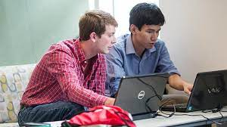
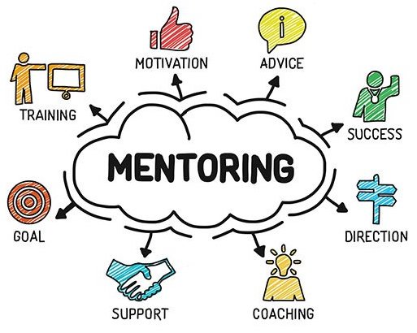
Solution
Connect CS students with mentors
Tailored Matching
Structured Guidance
Interactive Learning
Skill Development

Slide 4
Project Goal
Help students to grow in their skills and make university an easier place
Allow mentors to share their experiences and skills with others
Bring out the best in both student and mentor

Slide 5
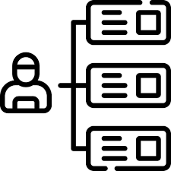
Use Case: Setting up a Mentorship
Preconditions:
User must be registered on the ByteBuddies program with a verified account and a full profile describing themselves as a student
Main Flow:
Registered user navigates to the “Request a Mentor” page from the Home Page
Fill out an application describing the kind of help you need and any special considerations (language, location, etc)
User selects from list of registered mentors, which then sends a confirmation request to the mentor who can accept / decline
Sub Flow:
A user searches through available mentors and finds a select mentor that they can set up a direct mentorship with
Alternative Flow:
No Available Mentors for the particular skills required was found
Send Resources to User in substitute of 1-1 mentoring like videos or helpful resources
Notes:
Nathan

Slide 6
References
“Mentoring Program.” College of Computing Mentoring Program, Georgia Tech, www.cc.gatech.edu/mentoring-program. Accessed 20 Sept. 2023.
“Purdue Computer Science Graduate Student Association.” Mentoring, www.cs.purdue.edu/gsa/mentoring.html. Accessed 20 Sept. 2023.

